Slide 2
Three phase half wave controlled rectifier
T₁ is fired at π/6 + α
T₃ is reverse biased and turned off
v_{d} = v_{an,} v_{T1} = 0, i_{T1} = i_{d}
T₂ is fired at 5π/6 + α
T₁ is reverse biased and turned off
v_{d} = v_{bn,} v_{T1} = v_{ab,} i_{T2} = i_{d}
T₃ is fired at 9π/6 + α
T₂ is reverse biased and turned off
v_{d} = v_{cn,} v_{T1} = v_{ac,} i_{T3} = i_{d}

Slide 3
For continuous current, Average output voltage

Slide 4
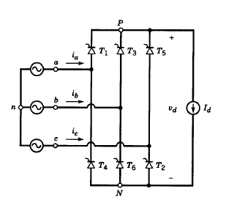
Three phase controlled Fullwave Rectifiers
constant load current.
Earliest instant at which T₁ can be turned on is at
Hence α is measured from π/6
π/6
Interval | Devices | V_{d} | i_{a} | i_{b} | i_{c}
A → B | T₆T₁ | v_{ab} | +I_{d} | -I_{d} | 0
B → C | T₁T₂ | v_{ac} | +I_{d} | 0 | -I_{d}
α
α
α
α
C → D | T₂T₃ | v_{bc} | 0 | +I_{d} | -I_{d}
α
D → E | T₃T₄ | v_{ba} | -I_{d} | +I_{d} | 0
V_{cn}
V_{an}
V_{bn}
E → F | T₄T₅ | v_{ca} | -I_{d} | 0 | +I_{d}
A
B
C
D
F → A | T₅T₆ | v_{cb} | 0 | -I_{d} | +I_{d}

Slide 5
Average load voltage
Average output Power =

Slide 6
AC side current i_{a}

Slide 7
RMS value of fundamental component I_{a1} =
RMS value of harmonic components I_{ah}=I_{a1}/h
h = 6n ± 1 , n = 1,2,3,…

Slide 8
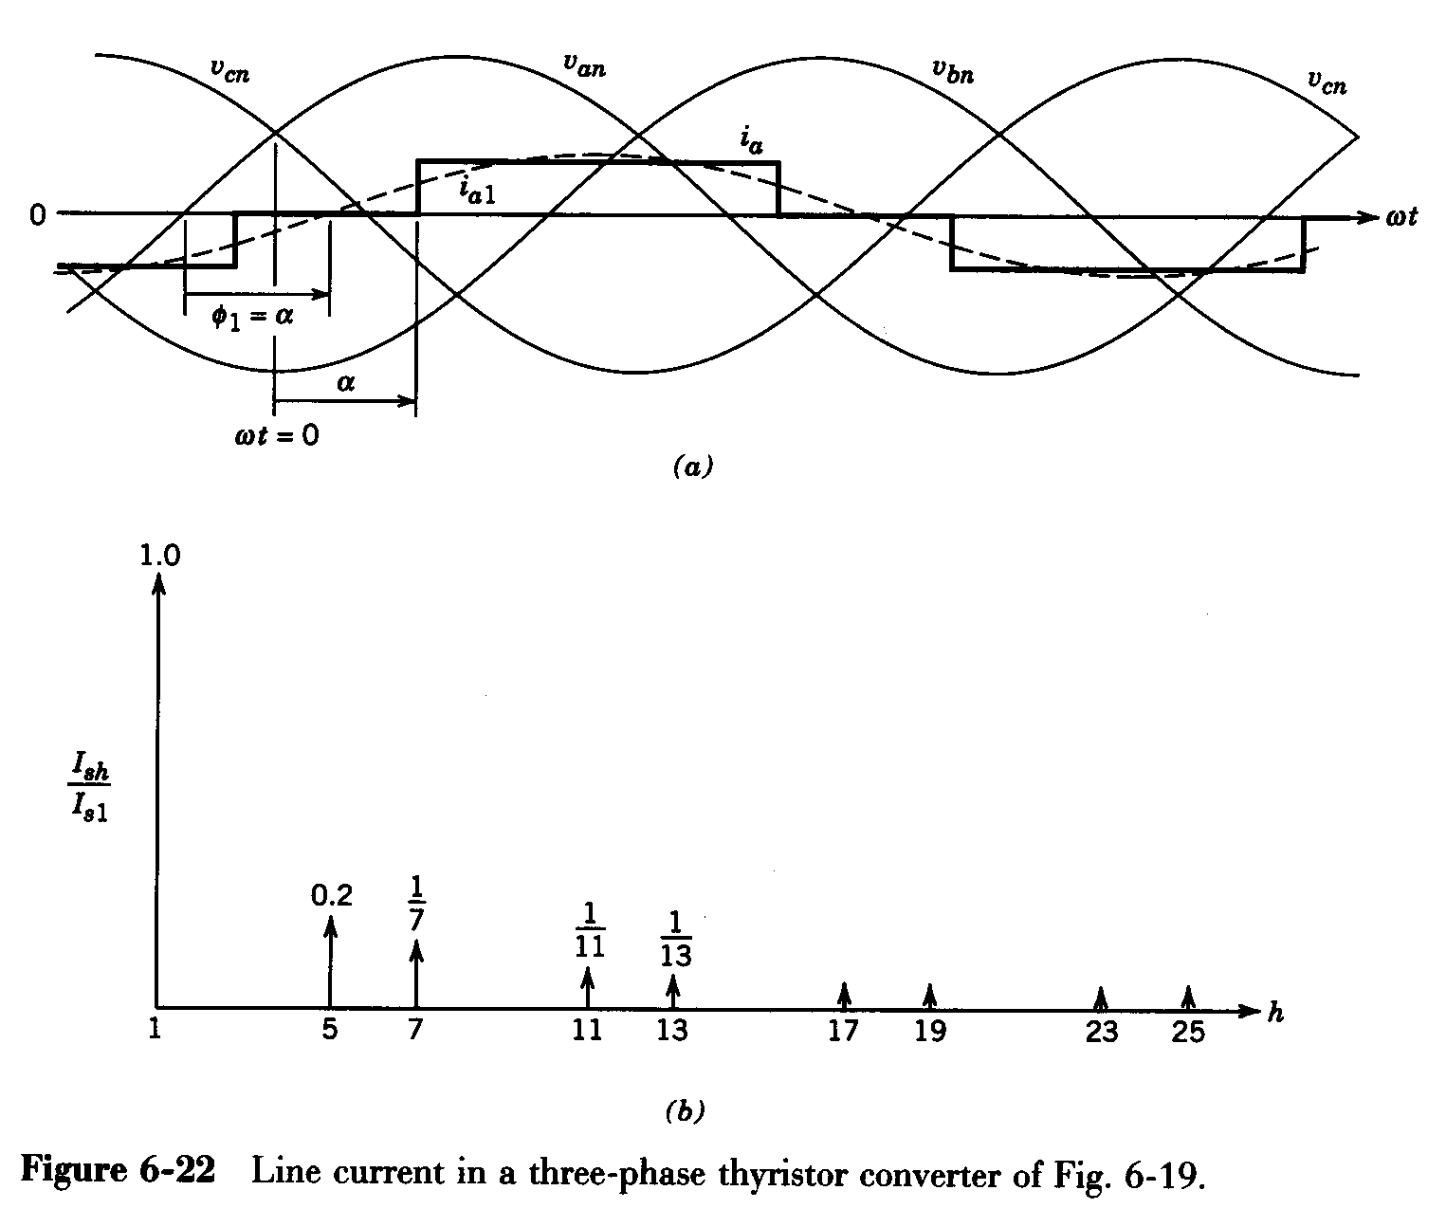

Slide 9
Total RMS value of phase current I_{a} =
THD =
DPF =
Power factor =

Slide 10
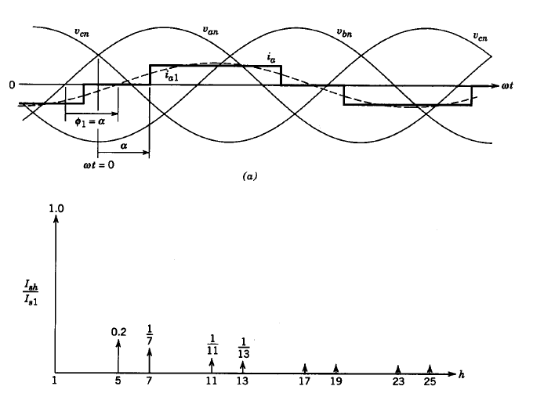
Harmonic spectrum

Slide 11
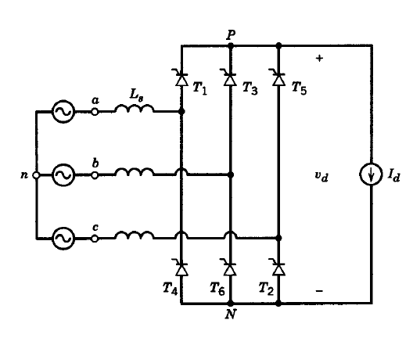
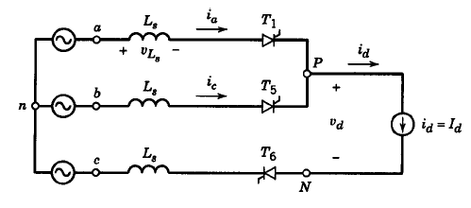
Effect of source inductance

Slide 12




T₅, T₆ and T₁ conduct
I_{d} =
∏/6 + α → ∏/6 + α + µ
c
v_{ac} = 2v_{Ls}
b

Slide 13

c
b
b
Equivalent ckt during π/6+α +µ to π/2+α
Equivalent ckt during π/6+α to π/6+α +µ
Average load voltage

Slide 14
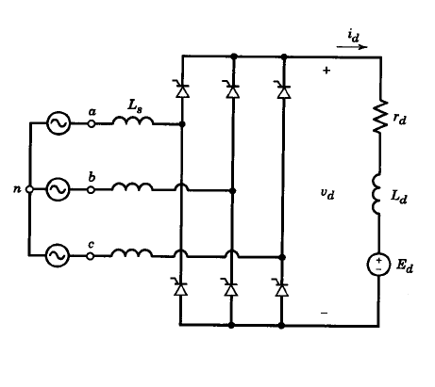
Practical 3 phase circuits

Slide 15
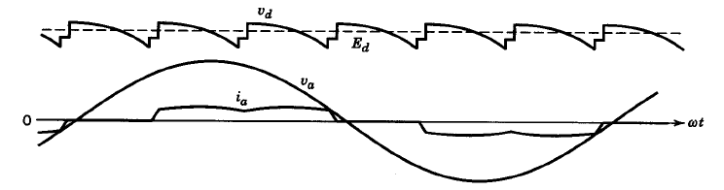
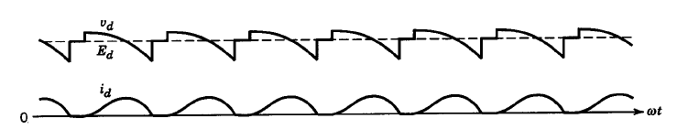
Continuous current mode
Discontinuous current mode

Slide 16
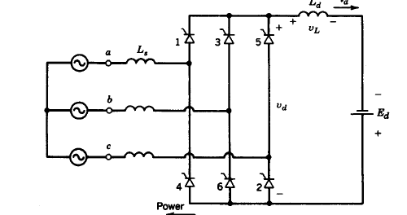
Inverter mode of operation

Slide 17
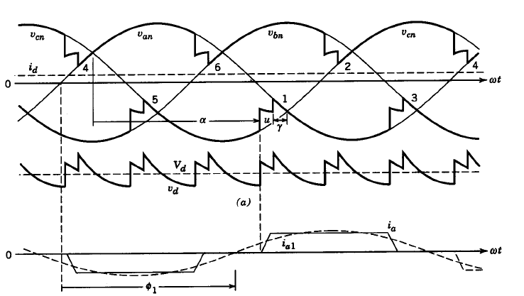
The extinction angle must be greater than thyristor turn of time tq.

Slide 18
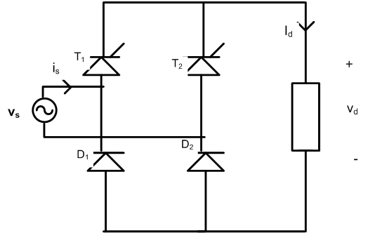
Single Quadrant Converters -Half Controlled converters
Symmetrical Configuration
Load current i_{d} is constant at I_{d}
α → π
T₁,D₂ Conduct
v_{d} = v_{s}
i_{s} = + I_{d}
i_{T1} = I_{d}
i_{D2} = I_{d}
Vs, vd,id,is,it1,vt1
i_{T2} = 0
i_{D1} = 0
π → π +α
T₁,D₁ Conduct
v_{d} = 0
i_{s} = 0
i_{T1} = I_{d}
i_{D2} = 0
π +α → 2 π
T₂,D₁ Conduct
v_{d} = -v_{s}
i_{s} = - I_{d}
i_{T1} = 0
i_{D2} = 0
2 π → 2 π +α
T₂,D₂ Conduct
v_{d} = 0 ,
i_{s} = 0 ,
i_{T1} = 0
i_{D2} = I_{d}
i_{T2} = I_{d}
i_{T2} = I_{d}
i_{D1} = I_{d}

Slide 19
Half-waving effect

Slide 20
Single Quadrant Converters -Half Controlled converters
Asymmetrical Configuration
α → π
T₁andD₂ Conduct
v_{d} = v_{s}
i_{s} = + I_{d}
i_{T1} = I_{d}
i_{D2} = I_{d}
π → π +α
D₁, D₂ Conduct
v_{d} = 0
i_{s} = 0
i_{T1} =0
i_{D2} = I_{d}
2 π → 2 π +α
D₁ , D₂ Conduct
v_{d} = 0
i_{s} = 0 ,
i_{T1} = 0
i_{D2} = I_{d}
π +α → 2 π
T₂,D₁ Conduct
v_{d} = -v_{s}
i_{s} = - I_{d}
i_{T1} = 0
i_{D2} = 0

Slide 22
Performance parameters
DC Side
Average load voltage
Average Power through the converter
P = V_{davg} I_{d} =
Average current rating of switching device =
RMS current rating of switching device =
PIV=

Slide 23

$$\sqrt{{{\left(a_{1}\right)}^{2}+{\left(b_{1}\right)}^{2}}_{}}$$

Slide 24
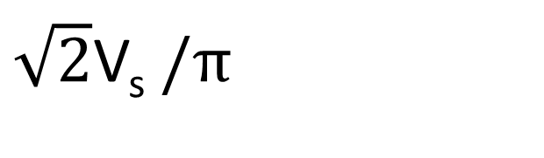
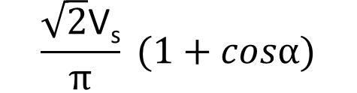
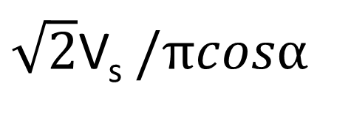
Average voltage
$\sqrt{2}$V_{s} $/πcosα$
Average voltage
$$\frac{\sqrt{2}\text{V}\text{s}}{π} (1+cosα)$$
Average voltage
$\sqrt{2}$V_{s} $/π$

Slide 25
Uncontrolled rectifier and Half controlled rectifiers Single quadrant (1st) of V_{d} -I_{d} plane
controlled rectifier Double quadrant (1st& 4th) in V_{d} -I_{d} plane

Slide 26
FOUR QUADRANT CONVERTERS
Two fully controlled converters are connected back to back
Dual Converters

Slide 27
Single Phase Dual Converters
Each converter has the ability to conduct current in one direction only.
Load current is bidirectional

Slide 28
Non-circulating current operation
Only one converter operates at a time and carries the entire load current.
V_{o} | I_{o} | Converter₁ | Converter₂
+ | + | Rectifier | ----
- | + | Inverter | ----
- | - | ----- | Rectifier
+ | - | ----- | Inverter
No current limiting reactor is required.
Slow and sluggish

Slide 29
Circulating current operation
Average voltages of both
converters are equal.
Instantaneous voltages are different.
This leads to a circulating current between the converters.
A reactor is inserted between the converters to limit this circulating current within limits

Slide 30
Average output voltages
V₀₁ = V_{0max} cosα₁
V₀₂ = V_{0max} cosα₂
V₀₁ = - V₀₂ = V₀
cosα₁ + cosα₂ = 0
α₁ + α₂ = 180⁰

Slide 31
At any instant one converter operates as rectifier while the other one operates as inverter.
To reverse the current, the roles of the converters are interchanged.
Response is very fast.
Drawbacks
A reactor is needed.
Losses associated with this decreases the efficiency. Power factor is reduced.
Devices are rated for a higher value to accommodate circulating current also.

